Slide 1

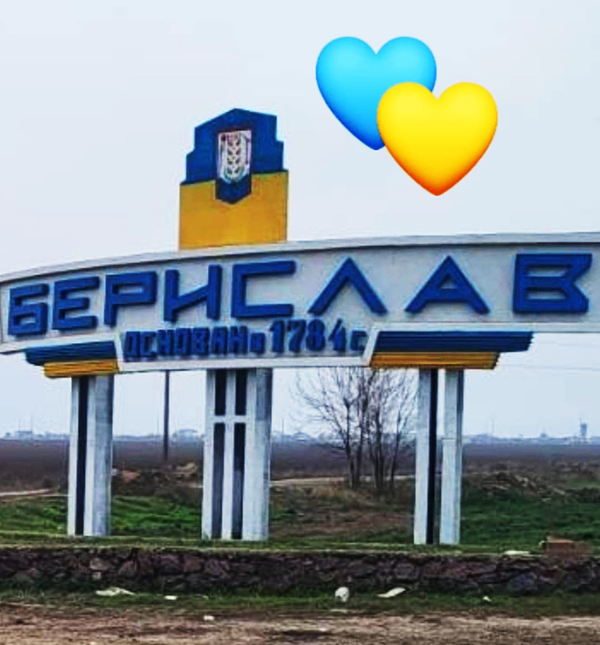
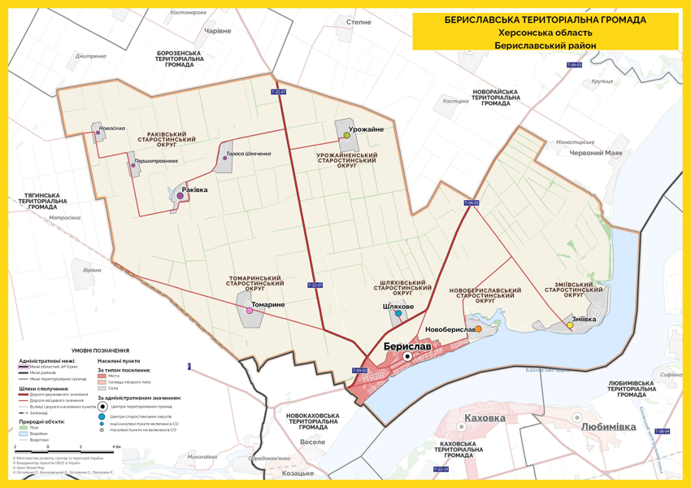

BERYSLAV
Beryslav Urban Territorial Community

Slide 2

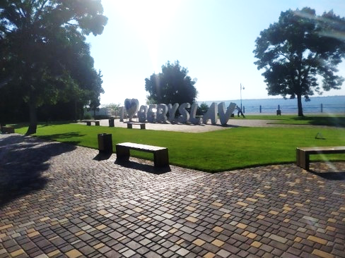
Brief description
1
It is located on the right bank of the Dnieper in the south of Ukraine in the Kherson region.
2
It is the administrative center of the Beryslav Urban Territorial Community
It has 2 400 inhabitants now (18 062- inhabitants before the full-scale invasion of the russian)
3

Slide 3
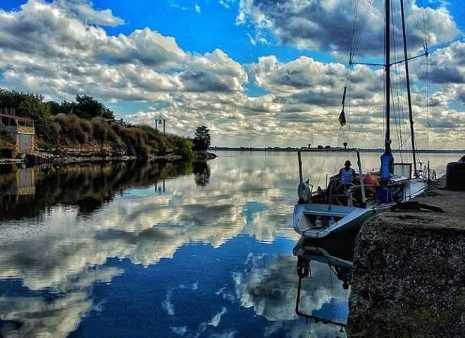
Brief description
4
The territory is 9.93 km²
5
Economics specialization: industry, agriculture.
6
The distance to the city of Kherson is 75 km by highway, to the city of Kyiv 613 km by highway
7
Governing body: Berislav city military administration.

Slide 4

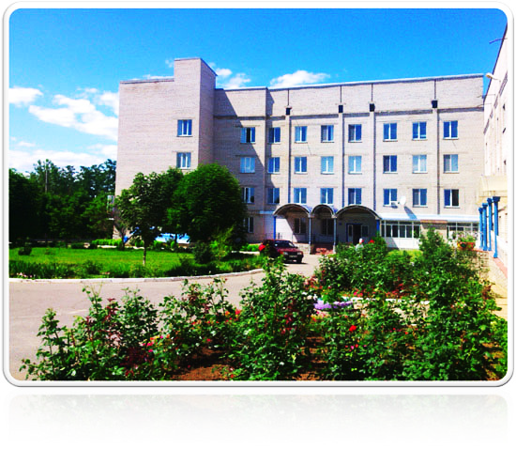

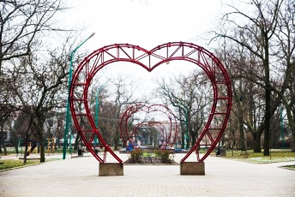

Beryslav is one of the oldest towns
in southern Ukraine (1784)
Good logistics: highway
T-0403 (Maryanske-Beryslav),
river port (pier), grain terminal
2 health care facilities, a House of Culture,
a museum, a library with Internet access

Slide 5
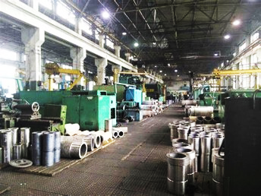


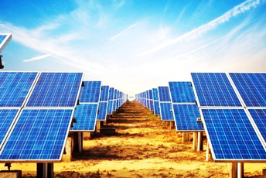


4 institutions of school education,
3 - preschool, 5 - after-school; medical and pedagogical colleges
3 hotels, 5 industrial enterprises;
powerful solar power plant.
830 small business entities and 46 farms.
Communal transport, taxi service;
centralized electricity, water, gas supply

Slide 6
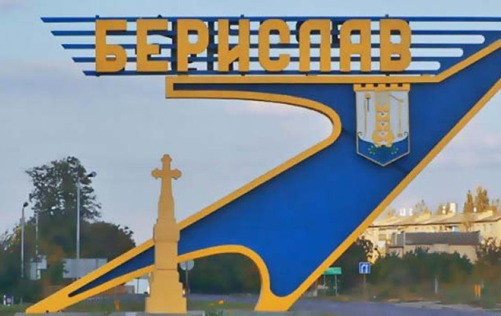


Сonsequences of russian aggression
During the 8.5 months of occupation, the population decreased by 73%.
Bridges, roads were damaged, electricity and gas networks were destroyed
Industrial enterprises and farmers stopped their activities

Slide 7
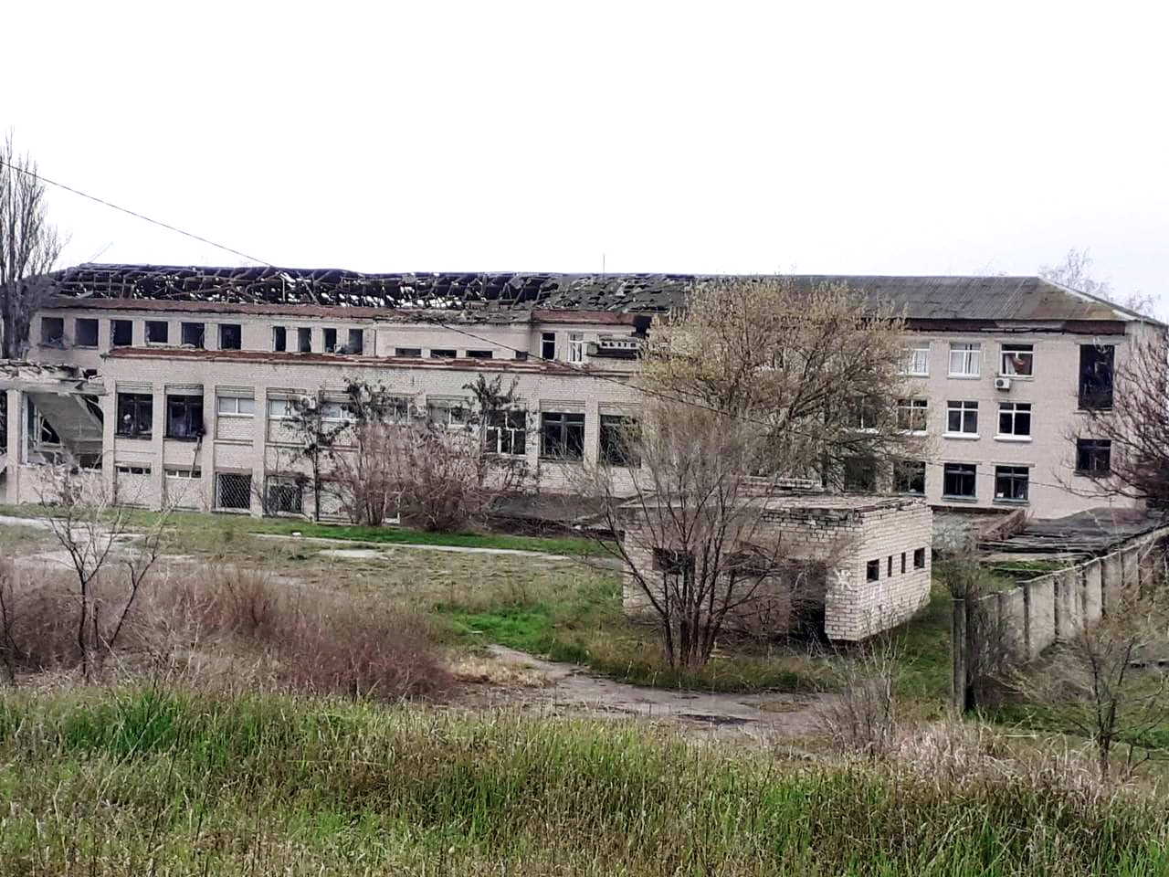
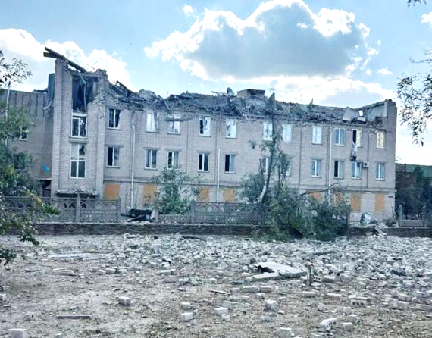
Сonsequences of russian aggression
4 educational institutions (100%)
2 healthcare facilities (100%)
Аlmost 40% of residential premises were damaged/destroyed

Slide 8
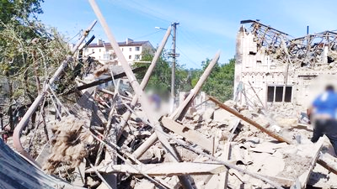
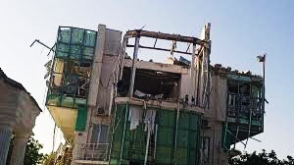
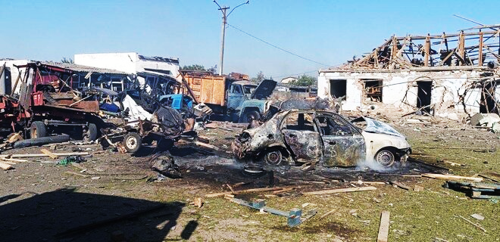
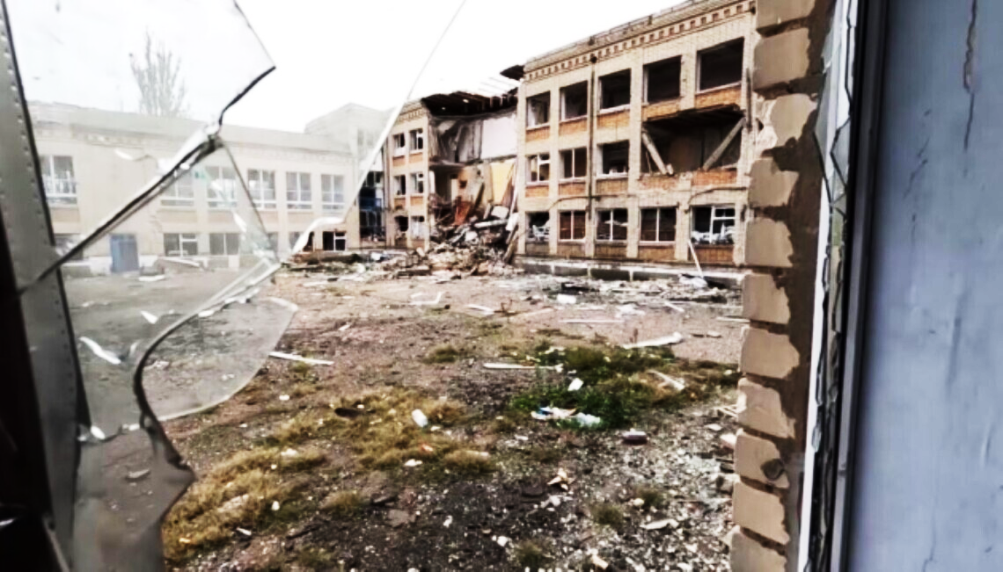

Slide 9
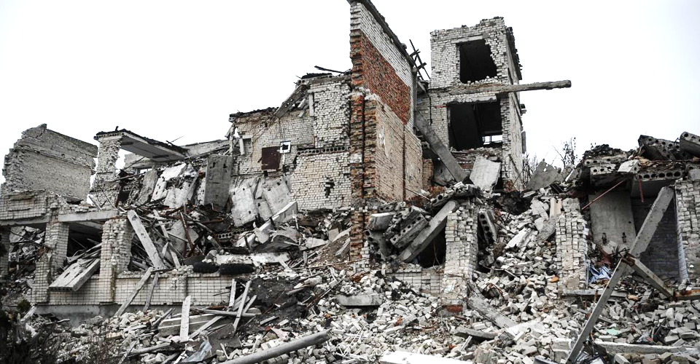
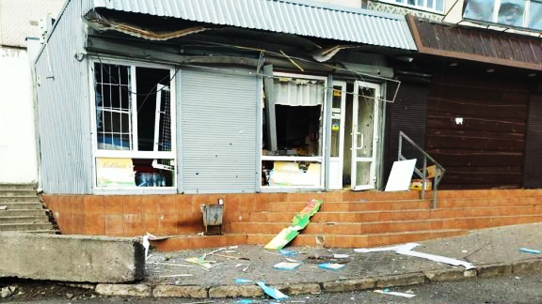
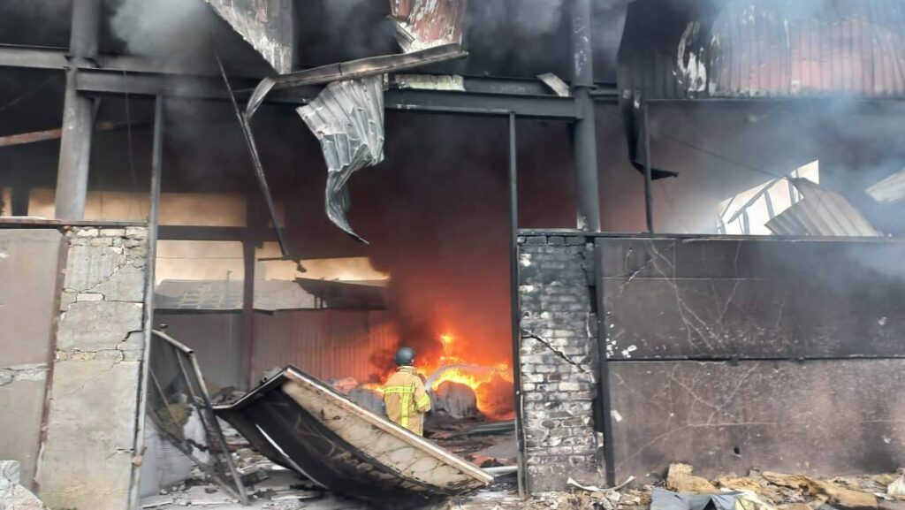
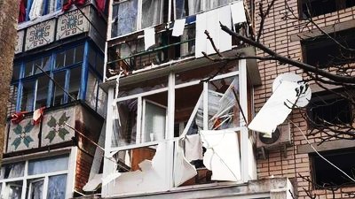

Slide 10
Main needs/challenges
I level
Security (territory demining,
warehouse equipment).
01
Assessment of damage and destruction, determination
of the level of losses and the potential
of socio-economic
development and the necessary resource.
02

Slide 11
Main needs/challenges
Ensuring the basic needs of residents who remain in the community.
Heating station equipment, mobile energy, water supply,
communication systems, food products
(this mission was
partially undertaken by the city government, the state,
and humanitarian organizations).
03

Slide 12
Main needs/challenges
IІ level
Restoration of critical infrastructure facilities based on the needs
and prospects of community development.
01
Restoration of the housing
stock
(where appropriate).
02

Slide 13

Main needs/challenges
IІ level
Evaluation and planning of reconstruction of the social
and economic potential of the community.
03
Restoration of good governance as a system - maximum involvement of all interested parties in the planning and implementation of community development projects.
04

Slide 14



Our vision of cooperation with municipalities
Involvement in the formation
of the recovery and development
plan of Beryslav TTC,
as well as expert support
on other issues.
Mediation in the development
of the business potential
of the two countries
(assistance in establishing
contacts between businesses).
Cooperation in the field of housing and communal services (in the water treatment plant project)

Slide 15
Our vision of cooperation with municipalities
Training of specialists (authorities) and residents on the use of advanced planning technologies, property management, etc.
Implementation of image projects in the community (cultural centers), or new infrastructure projects (educational hub), water supply, etc

